Slide 1











Your Account
Home
Menu
About Us
Contact
SB FOODS
WWW.SBFOODS.COM
PRESENTED BY
TEAM - G
DANUSHIYA P DIVYA S HEMAHARINI N MANISHA M

Slide 2

Your Account
Home
Menu
About Us
Contact
ABOUT OUR RESTAURANT
An innovative online food ordering platform designed to deliver a user-friendly experience for customers, restaurants, and administrators.
Mission:
To simplify and enhance the food ordering experience through technology, providing convenience for users, operational efficiency for restaurants, and streamlined management for admins.

Slide 3

Your Account
Home
Menu
About Us
Contact
ABSTRACT
SB Foods is an innovative online food ordering platform designed to enhance the user experience by seamlessly connecting customers, restaurants, and administrators. Built using the MERN stack (MongoDB, Express.js, React, Node.js), it offers a responsive, scalable, and secure solution for food ordering. The platform provides a user-friendly interface for customers to browse menus, manage orders, and track deliveries, while restaurants benefit from efficient menu management and order processing. Administrators have access to a robust dashboard for managing users, products, and overall operations. SB Foods aims to revolutionize the food ordering process, making it more accessible and efficient for all stakeholders.

Slide 4
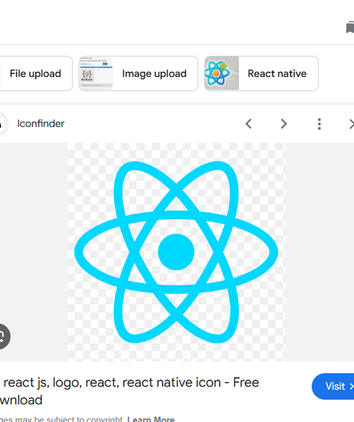
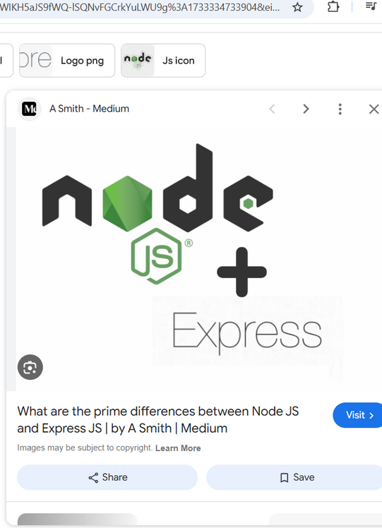
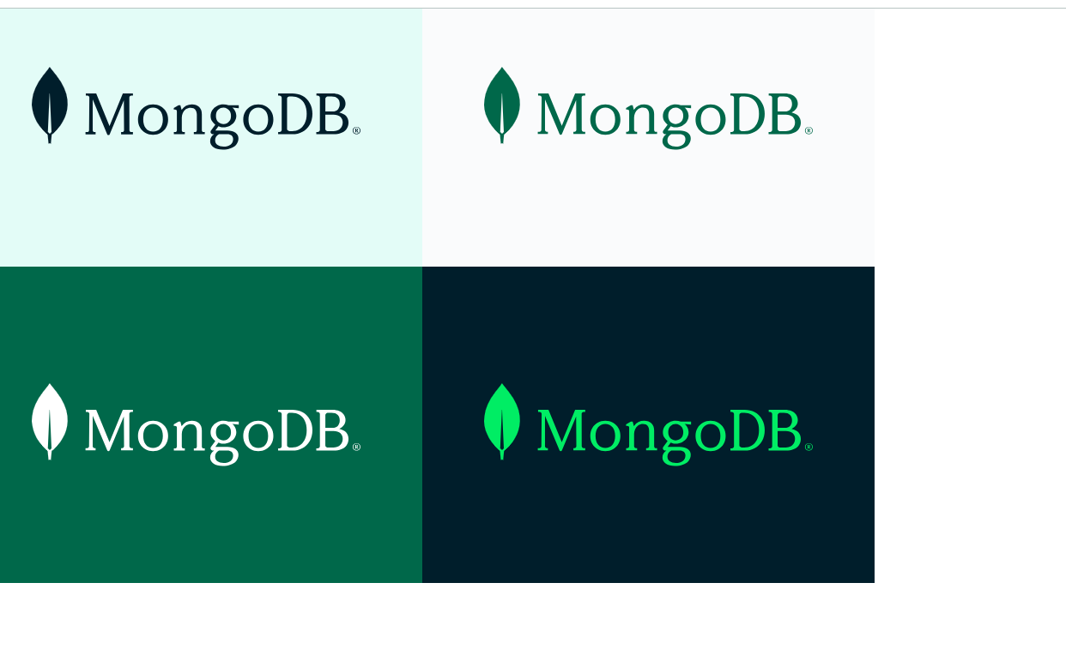
Your Account
Home
Menu
About Us
Contact
TECHNICAL ARCHITECTURE
Frontend
Backend
Database
React.js
User-friendly interface for customers, restaurant owners, and admins.
Node.js + Express
Handles user authentication, product management, and order processing.
MongoDB
Stores user profiles, restaurant data, product listings, and orders.

Slide 5
Your Account
Home
Menu
About Us
Contact
SETUP INSTRUCTIONS
Prerequisites and Installation Steps
Prerequisites
Clone the Repository
Navigate to Server Directory
Before starting, ensure Node.js and MongoDB are installed for project functionality.
Use the command 'git clone https://github.com/Danushiya/SB-Foods' to download the project files.
Change directory to the server folder using 'cd server' to access backend files.
Start the Backend Server
Access the Application
Install Backend Dependencies
Execute 'npm start' to launch the backend server, making it accessible at http://localhost:27017.
Open your browser and go to http://localhost:3000 to access the SB Foods application.
Run 'npm install' to install all required packages for the backend server.

Slide 6
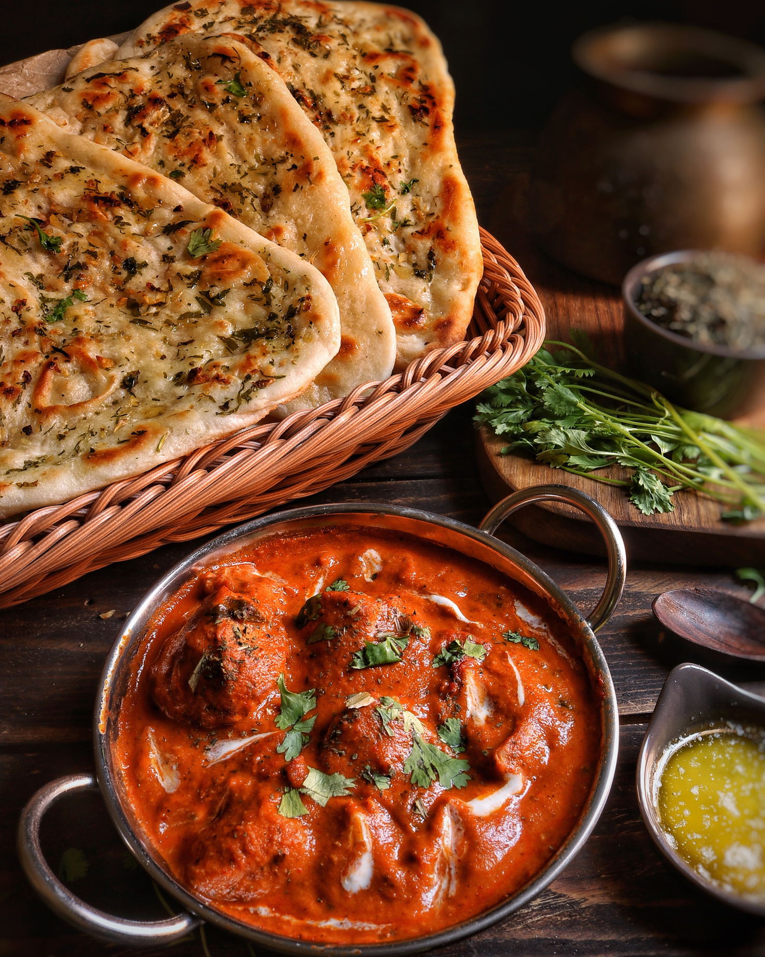

Your Account
Home
Menu
About Us
Contact
PROBLEM STATEMENT
Customer Pain Points:
Difficulty in finding restaurants that match specific tastes.
Lengthy and complex order processes.
Lack of personalized food recommendations.
01
Restaurant Challenges:
Managing orders, inventory, and product listings manually.
Delayed communication and approval processes for new dishes.
02
Admin Struggles:
Managing user accounts, food items, and orders through different systems.
03

Slide 7

Your Account
Home
Menu
About Us
Contact
SOLUTION OVERVIEW
For Users: Seamless registration, login, browsing, ordering, and payment.
01
For Restaurants: Easy product listing, editing, and order management.
02
For Admins: Efficient user, product, and order management through a dedicated dashboard.
03

Slide 8


Your Account
Home
Menu
About Us
Contact
APPLICATION FLOW
User Flow
Users start by registering for an account.
After registration, they can log in with their credentials.
Once logged in, they can check for the available products in the platform.
Users can add the products they wish to their carts and order.
They can then proceed by entering address and payment details.
After ordering, they can check them in the profile section.
Order Now

Slide 9
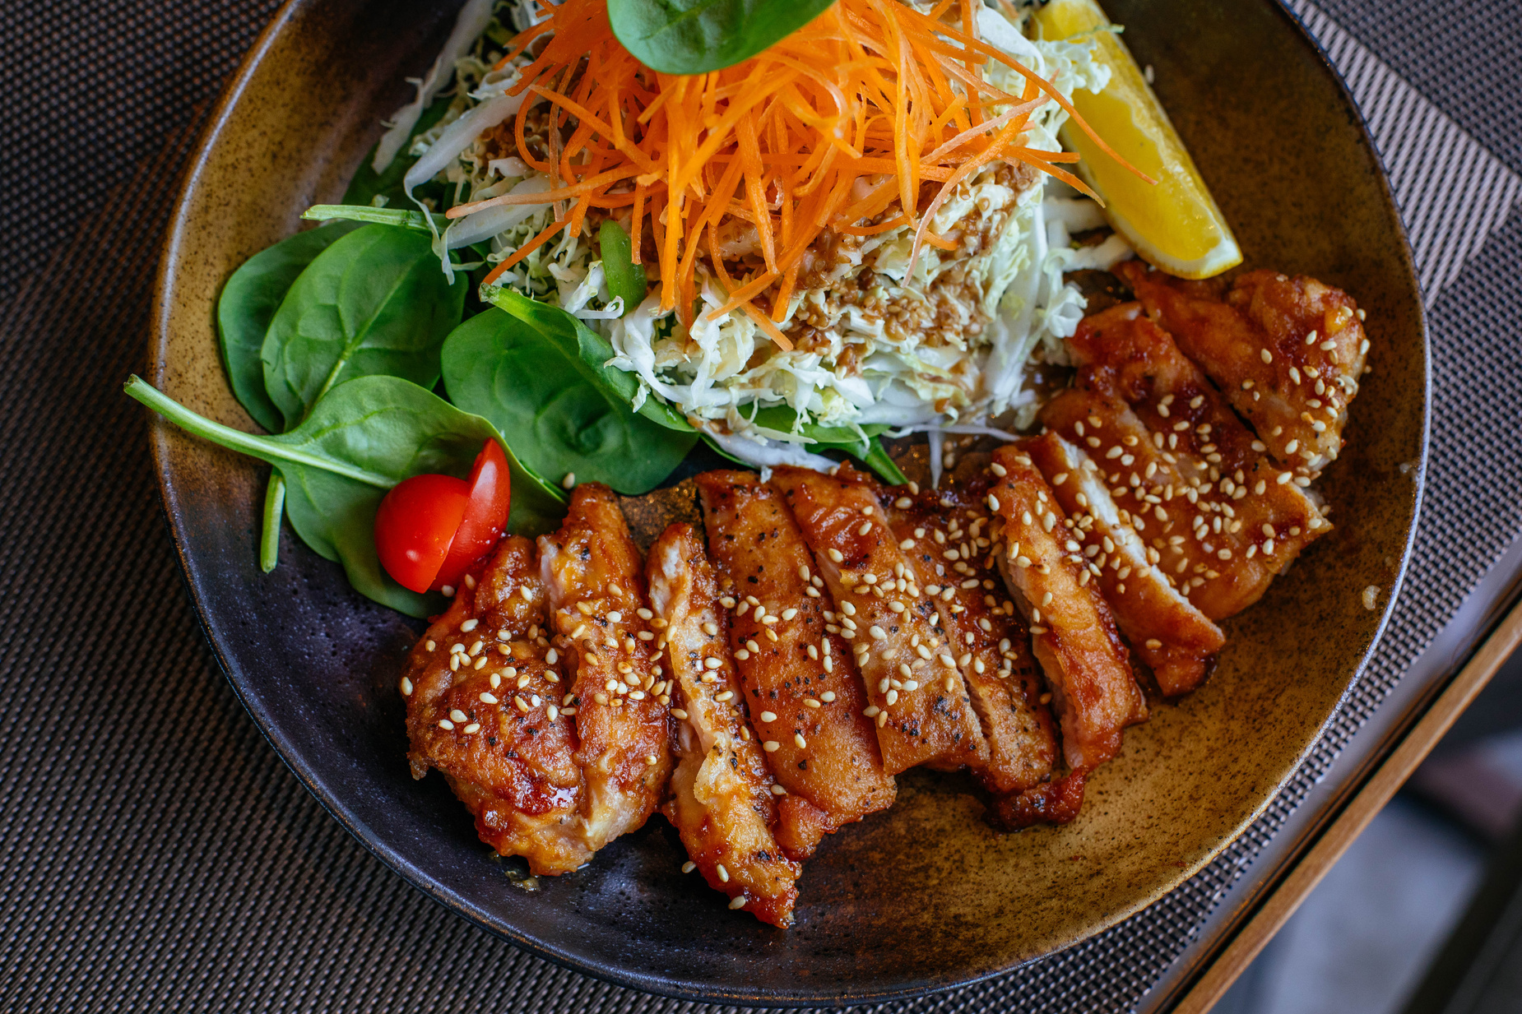
Your Account
Home
Menu
About Us
Contact
APPLICATION FLOW
Restaurant Flow
Restaurants start by authenticating with their credentials.
They need to get approval from the admin to start listing the products.
They can add/edit the food items.
Order Now

Slide 10

Your Account
Home
Menu
About Us
Contact
APPLICATION FLOW
Admin Flow
Admins start by logging in with their credentials.
Once logged in, they are directed to the Admin Dashboard.
Admins can access the users list, products, orders, etc.
Order Now

Slide 11
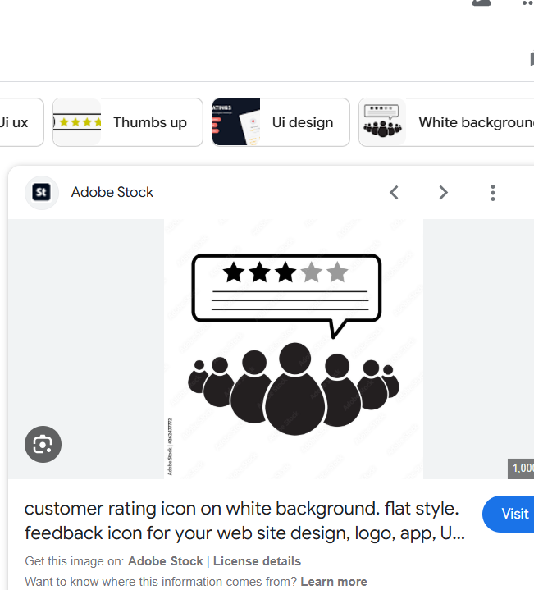
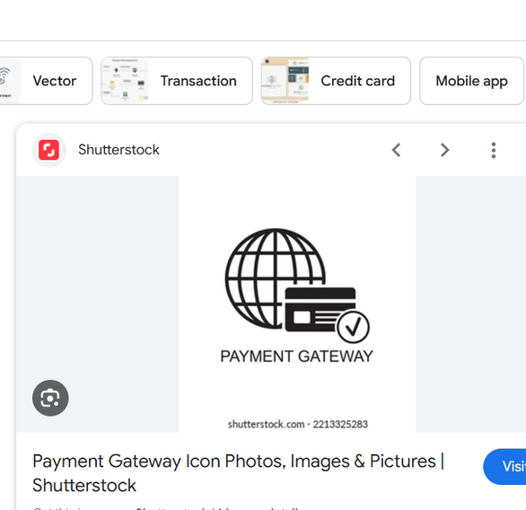
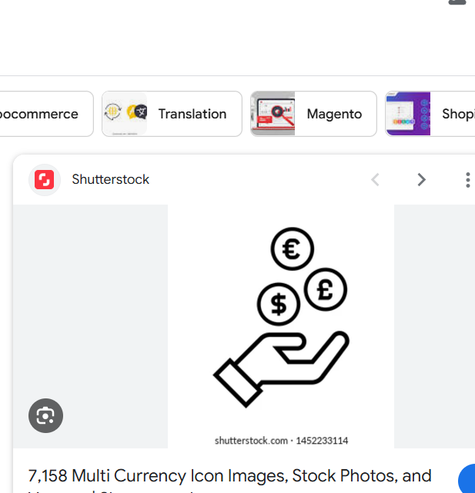
Your Account
Home
Menu
About Us
Contact
FUTURE ENHANCEMENTS
User Review and Rating System
Payment Gateway Integration
Multi-language and Currency Support
Allow customers to leave reviews and ratings for products and restaurants, fostering better feedback and aiding decision-making.
Integrate a secure payment gateway like Stripe or PayPal for direct in-app transactions, streamlining the ordering process.
Enable language and currency changes based on user location or preferences, attracting international users and fostering inclusivity.

Slide 12

Your Account
Home
Menu
About Us
Contact
DEMO
Show a working demo of the SB Foods platform, highlighting key features such as product browsing, placing an order, and viewing the admin dashboard.

Slide 13


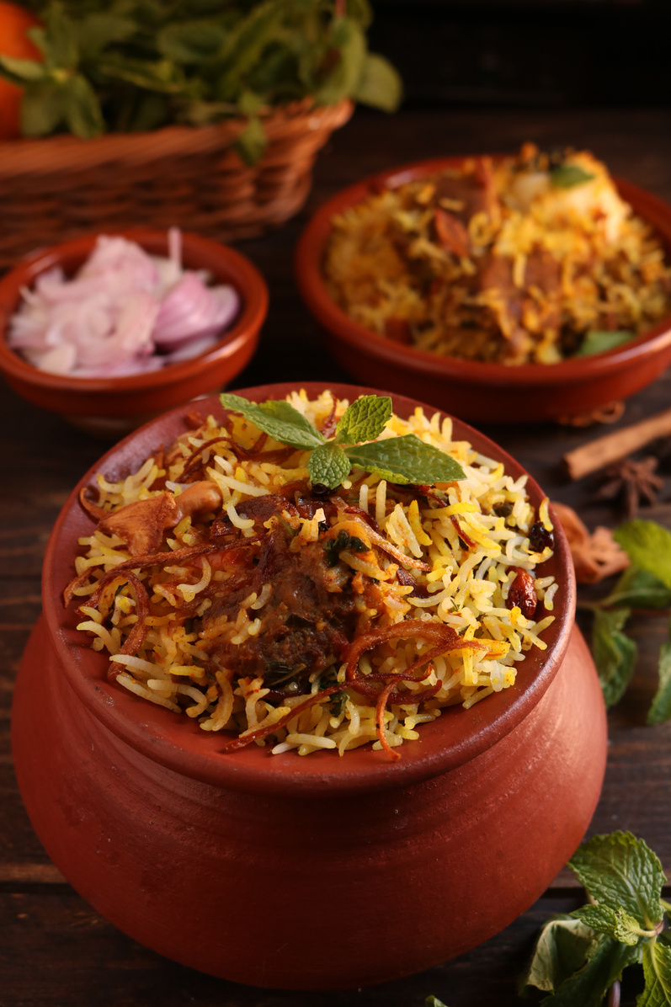



Your Account
Home
Menu
About Us
Contact
CONCLUSION
SB Foods is a robust platform transforming the food ordering experience with user-friendly features, advanced management tools, and secure technology. Its scalable architecture ensures efficiency for users, restaurants, and admins while laying the foundation for future growth in the competitive food service industry.
Thank You

Slide 14
Your Account
Home
Menu
About Us
Contact
THANK YOU FOR CHOOSING SB FOODS!
We are truly grateful for your visit and your order. Your support inspires us to keep delivering delicious meals and exceptional service. We look forward to serving you again soon!
Bon Appétit! 🍴
SB Foods - Where Flavor Meets Convenience!

